Slide 1
Rail Delay Problem Formulation
Jacob Heglund

Slide 2
Problem Formulation

Slide 3
Problem Formulation
We want to predict the delay of the entire rail network simultaneously
More specifically, we will be predicting the delay of every train at it’s next stop
At the same time, we will be considering the reactionary delay effects that trains have on each other
In order to consider the rail network simultaneously, we must first transform our available data into a usable form

Slide 4
Data Transformation
The raw data is structured s.t. each train route is indexed by its stations
This poses a problem because this local index does not transfer between two different train routes
That is to say, train stations do not work as a global index
Our solution to this indexing problem involves switching to a global index
We sample the raw data at set time intervals (for example, every T = 15 minutes) to form a time-indexed dataset

Slide 5
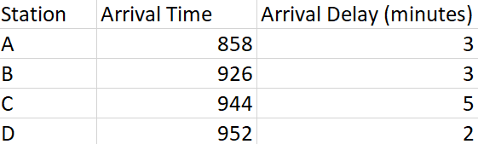
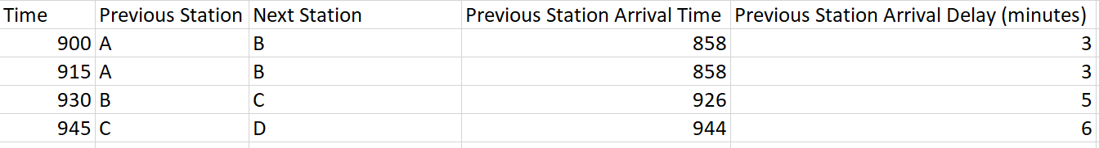
Data Transformation
Example of station-indexed data for a single train
Example of time-indexed data for a single train

Slide 6
Data Transformation
There are some problems that may arise from this time-indexed formulation
How to predict multiple “stations” in the future?
Solution: Choose N_future s.t. it captures the longest time gaps between stops
Repeated predictions
Our model will output the same “next station” prediction multiple times if a train does not each it’s next station within the time interval
Despite potential issues, time indexing is the best method for structuring the data for our particular problem formulation

Slide 7
Data Transformation
A note on time indexing
If a train is sitting at Station A, then Station A is considered as the “previous station”
Why this definition?
The arrival delay for Station A is in the past at that point in time, and we will be predicting the arrival delay at the next station
Therefore this definition makes sense given a time-indexed dataset

Slide 8
Problem Formulation
We formulate the problem as a regression problem
We plan to use similar metrics from Simon’s first paper to allow a direct comparison of results
RMSE, MAE, MAAPE (mean arctan percentage error)
We propose the following features
Input: z-score of arrival delay (in minutes) at the previous N_past timesteps
Output: predicted z-score of arrival delay at the next N_future stations
N_past and N_future are the number of timesteps as input and output respectively

Slide 9
Problem Formulation
This work will include multiple input and output features as well
This allows a direct comparison with Simon’s paper
Input: takes the form as seen on page 10 of the paper
Output: contains the variables predicted in the paper
Deviation from arrival, deviation from departure, travel time, dwell time

Slide 10
Graph Formulation
There are complicated interactions in the rail network
These interactions are difficult to model directly
Therefore, we use a graph neural network to implicitly account for these interactions
This is done by training on past rail network data
A graph G(V, E) is defined by it’s nodes (or vertices) and edges
We define the nodes as follows
Each node is a unique train route scheduled during the data period
A route is said to be unique if the starting station, ending station, and starting time are different from all other routes in the data period
This formulation gives a constant number of N nodes on the graph for the data period

Slide 11
Graph Formulation
The adjacency matrix defines the connections between nodes on the graph
These connections are referred to as “edges”
We define the graph edges as follows
A(i, j) = 1 if train i and j are “interacting”
= 0 otherwise
“Interacting”: two trains are said to be interacting iff:
They are travelling in the same direction
Both trains are scheduled to arrive at the same station within some time radius Δ of each other
Might need to consider “two trains have either the same previous stop and / or the same next stop” if time radius is difficult to establish

Slide 12
Graph Formulation
“Travelling in the same direction”
Create enumeration f which maps each station with an index
f(A) = 1, f(B) = 2, f(C) = 3, f(D) = 4
Example
Train #1 with origin-destination (OD) pair (A, D) will have a starting-ending difference of 1-4 = -3
Train #2 with OD pair (C, A) will have a starting-ending difference of 3-1 = 2
We will refer to this value as OD_diff
Therefore,
Routes with positive OD_diff travel eastward
Routes with negative OD_diff travel westward
A
B
C
D

Slide 13
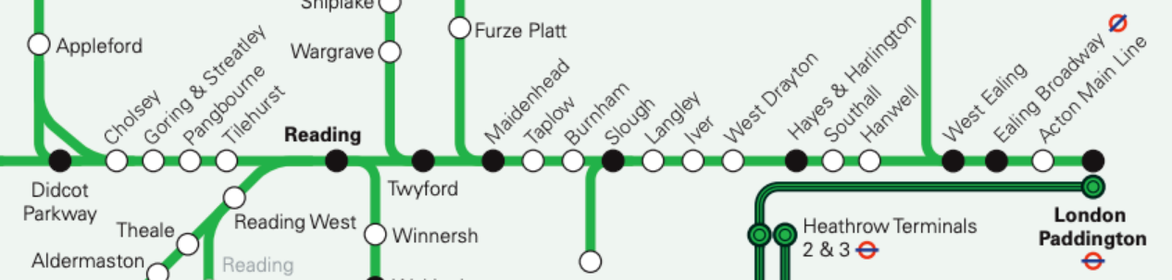
Graph Formulation
“Travelling in the same direction”
Two routes are said to be travelling in the same direction if the OD_diff of both routes have the same sign
This definition is possible because there is a strict order of stations in our dataset
Stations included in this study are intersected by the red line below
http://www.projectmapping.co.uk/Reviews/Resources/GWR%20HEX%202019%20Map%20-%20Image%20(1.png

Slide 14
Graph Formulation
“Both trains are scheduled to arrive at the same station within some time radius Δ of each other”
This part of the definition was chosen to help model reactionary delay effects in the rail network
Reactionary delay is difficult to model
It involves complex feedback between trains that is not well-understood
This condition captures important aspects of train interactions at stations
This allows the neural network model to implicitly compensate for reactionary delay in its predictions

Slide 15
Problem Specifics
We now define preliminary values for variables defined in the previous slides
T = 5 (minutes between data samples for index transformation)
N_past = 12 (number of model input timesteps)
This means our model could start predicting N_past * T minutes after the data for each day begins
N_future = 1 (number of model outputs)
i.e. delay at the next station
Δ = 30 (time radius for two interacting trains in minutes)

Slide 16
Solution Approach

Slide 17
Model Architecture
We use a graph neural network to predict the rail network delays simultaneously
Our problem falls under the taxonomy of a “Time-Varying Spatio-Temporal (TVST) Graph”
OR DYNAMIC ST GRAPH
Time-Varying: Graph edges may change over time, giving a time-varying adjacency matrix A = A(k)
Spatio-Temporal: Node features (also called spatial data) may change over time, giving a time-varying feature matrix X = X(k)

Slide 18
Proposed Model Architecture
There are multiple relevant timescales for the rail network prediction problem
Hourly, daily, weekly data are all relevant
Each sub-model would capture information at the appropriate timescale
Information is then fused together in the output layer
Sub-Model Input
(Xh, Ah)
Sub-Model (hourly)
Fully
Connected
Concat
Feature Vector
Output Layer
Sub-Model Input
(Xd, Ad)
Sub-Model (daily)
Fully
Connected
Model Prediction
Sub-Model Input
(Xw, Aw)
Sub-Model (weekly)
Fully
Connected

Slide 19
Sub-Model Input
(Xh, Ah)
Sub-Model (hourly)
Fully
Connected
Concat
Output Layer
Feature Vector
Sub-Model Input
(Xd, Ad)
Sub-Model (daily)
Fully
Connected
Model Prediction
Sub-Model Input
(Xw, Aw)
Sub-Model (weekly)
Fully
Connected

Slide 20
Proposed Model Architecture
Our architecture takes a stacked-block form
Deeper architectures have not shown the same effectiveness for graph networks as with CNNs
To reduce training overhead, an architecture with 2 TVST blocks would be reasonable
If our architecture were deeper, we would employ skip or dense connections between blocks to improve training
Sub-Model Input
(X, A)
Sub-Model
Sub-Model Output
TVST Block
TVST Block
…
TVST Block
TVST Block

Slide 21
Proposed Model Architecture
The basic building block of the architecture is shown below
Temporal = gated dilated causal temporal conv or temporal attention
Spatial = Spatial Attention (“spatial” graph convolution)
These methods are discussed in more detail in the following slides
Block Input
X, A
Temporal
Spatial
Temporal
Block Output
ŷ[k]
residual connection

Slide 22
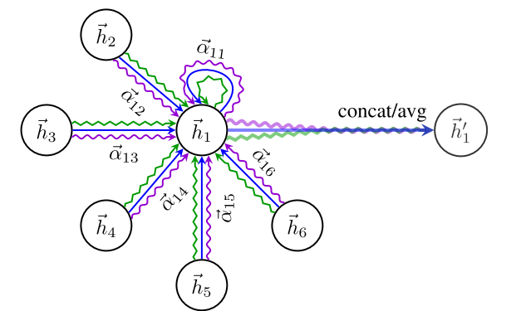
Proposed Model Architecture
Spatial Aggregation Method
Multi-headed attention
Learns an importance weighting between a node and its neighbors
Creates an embedding of the information contained in the nodes
Allows the prediction of a graph as the output of the network
Why this method?
Effectively transmits information along the edges of a graph
Able to adapt to the changing graph structure

Slide 23
Proposed Model Architecture
Temporal Aggregation Methods
Dilated, causal, gated temporal convolution
First proposed in WaveNet (van den Oord, 2016)
Computationally inexpensive to train compared to RNN while effectively capturing temporal information
Used in state-of-the-art ground traffic forecasting papers
Temporal Attention
Learns an importance weighting on input-timesteps and predictions
Used in state-of-the-art ground traffic forecasting papers

